Slide 1
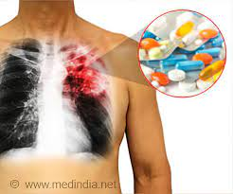
Drug induced lung diseases
By
Maha Elkholy
Professor of pulmonology

Slide 2
Definition
A common clinical problem in which a patient without previous pulmonary disease develops respiratory symptoms.
This lung disease brought on by a bad reaction to a medicine (drug).

Slide 3
Drug-induced pulmonary diseases can present in a variety of syndromes , clinical presentations , and radiographic patterns .
The most common presentations of drug-induced pulmonary disease are an abnormality on a chest radiograph or a symptom complex

Slide 4
Syndromes of drug induced pulmonary disease
Asthma
Bronchiolitis obliterans organizing pneumonia
Hypersensitivity infiltrate
Interstitial pneumonitis or fibrosis
Non cardiogenic pulmonary edema
Pleural effusions
Pulmonary infiltrates with eosinophilia
Pulmonary vascular disease

Slide 5
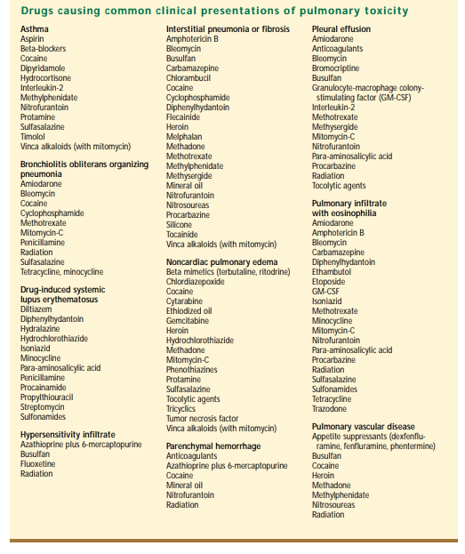

Slide 6
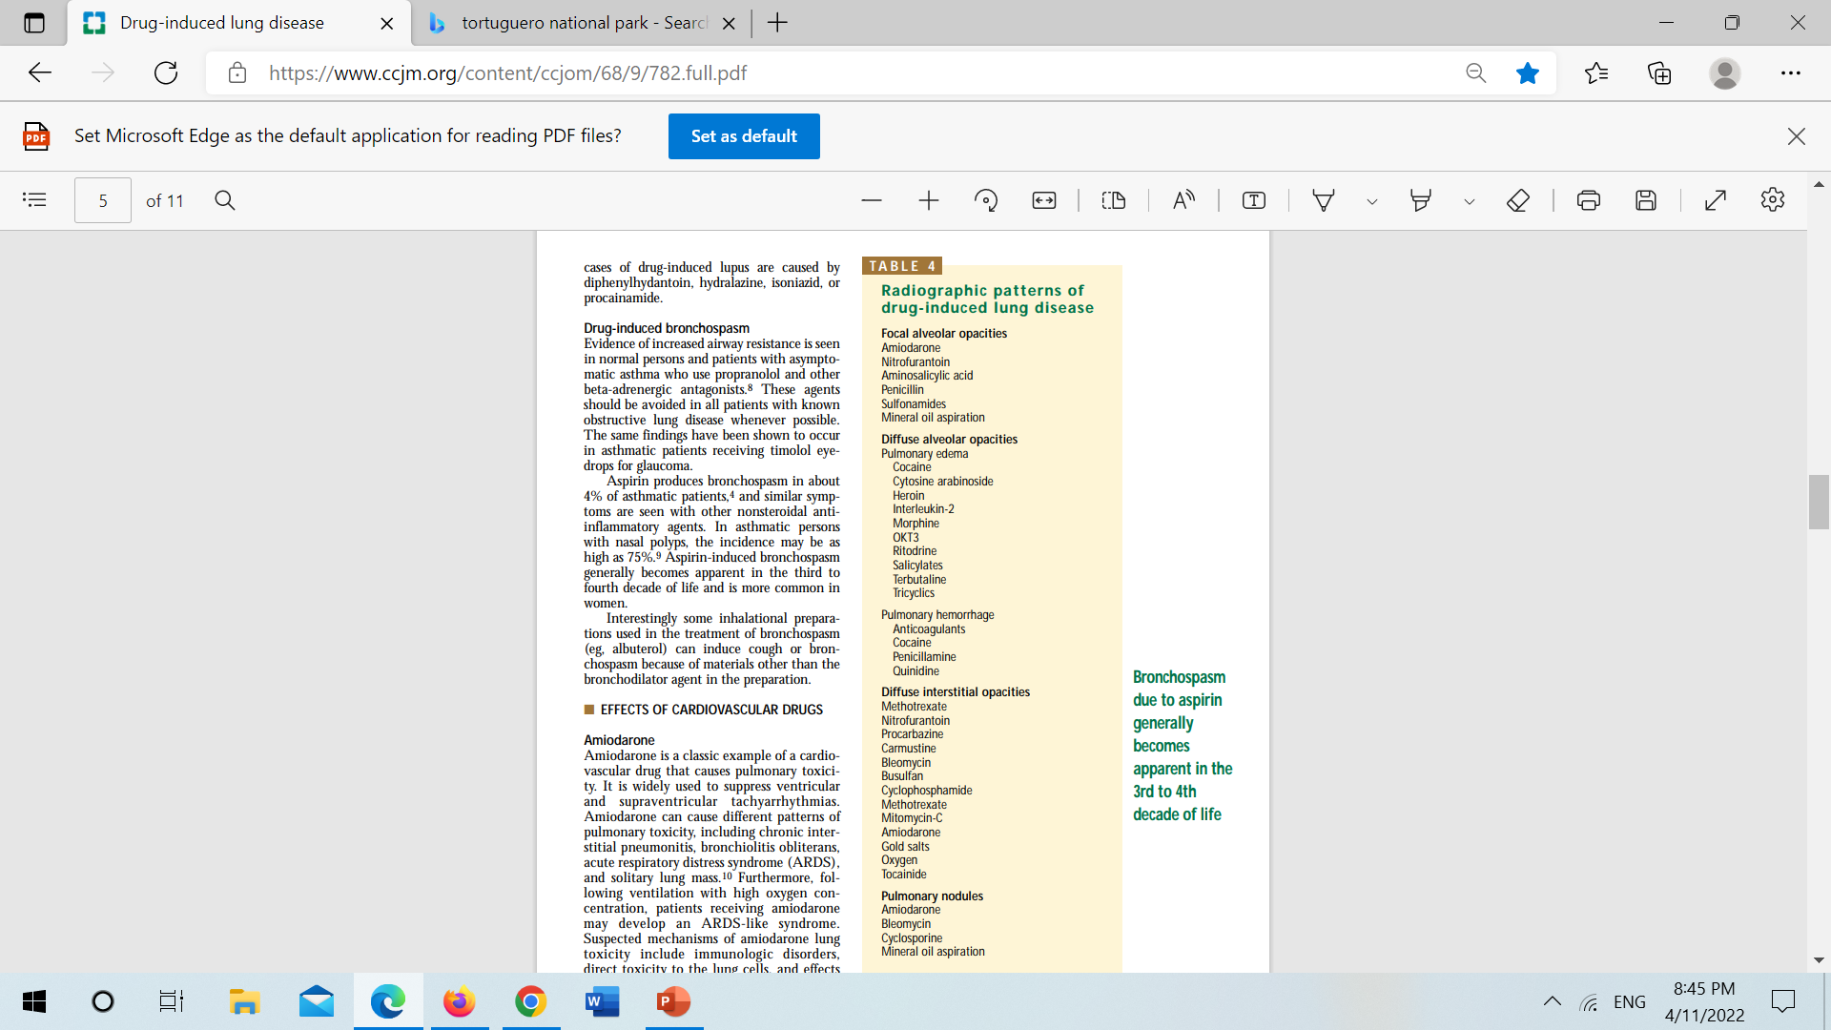
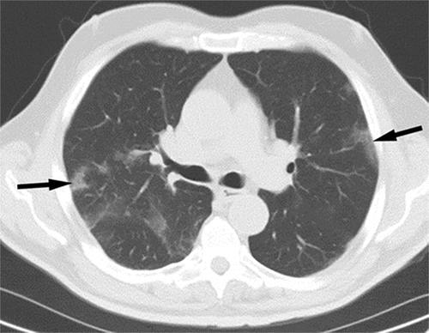
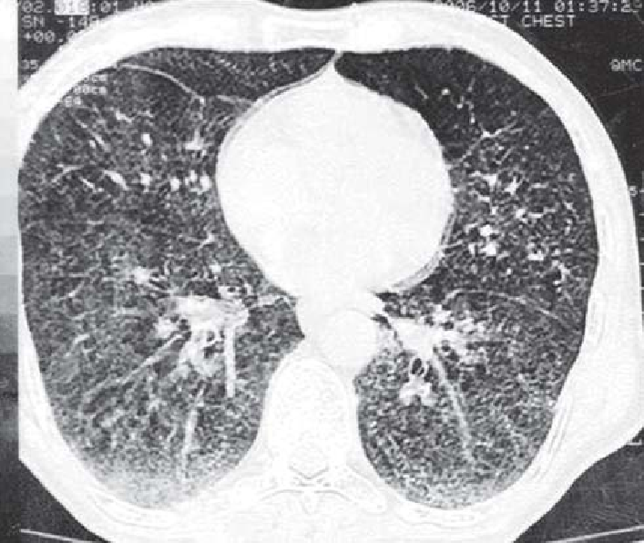
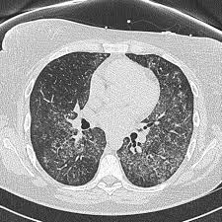
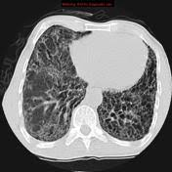
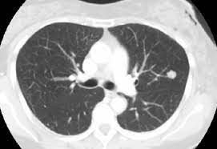
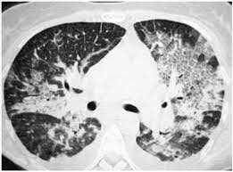

Slide 7
Noncardiogenic pulmonary edema
It manifests as acute respiratory distress occurring over several hours.
Capillary endothelial injury→ causing increased permeability edema.
Physical examination demonstrates diffuse crackles,
Chest roentgenograms show diffuse ill-defined acinar infiltrates and normal heart size.
laboratory examination shows significant hypoxemia
Cocaine and Heroin are the most common cause

Slide 8
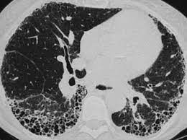
Interstitial pneumonitis or fibrosis
Acute pneumonitis may present in a manner similar to noncardiogenic pulmonary edema
In the chronic form, manifestations are a slowly progressive cough, dyspnea, weight loss, and clubbing.
Radiographic findings are usually reticular infiltrates starting in the subpleural region of the lung bases and progressing to include the entire lung.
The prognosis generally is worse than for drug-induced noncardiogenic pulmonary edema
Bleomycin, cocaine , methotrexate are common causes

Slide 9
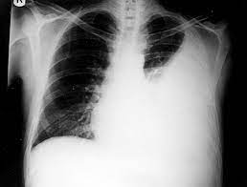
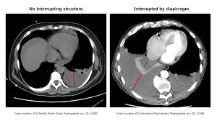
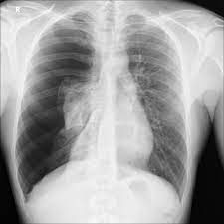
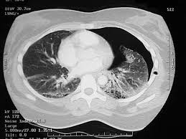
Pleural and mediastinal disorders
Pleural effusions that resolve spontaneously or with discontinuation of the drug are seen in drug-induced systemic lupus erythematosus.
Pneumothorax may complicate systemic chemotherapy and illicit drug use.
Hemothorax or mediastinal hematoma can be a complication of anticoagulants.
Mediastinal adenopathy may be a complication of cyclosporin, or methotrexate use.
Mediastinal lipomatosis may complicate corticosteroid use.
An acute pleural effusion in association with drugs can also been seen as part of a hypersensitivity reaction.

Slide 10
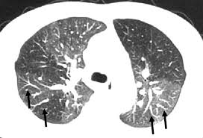
Pulmonary vascular disease
The incidence of pulmonary veno-occlusive disease, characterized by the occlusion of pulmonary venules with subsequent elevated pulmonary arterial pressures,
It is increased in patients receiving cytotoxic agents for the treatment of malignancy.
The diagnosis usually requires an open lung biopsy.
Illicit drugs can cause angiitis and hypertension.
Alpha adrenergic nasal sprays have been associated with interstitial fibrosis and obliteration of pulmonary vessels.
Estrogen-containing drugs as well as appetite suppressants have been associated with development of pulmonary hypertension

Slide 11
Drug-induced lupus
Symptoms include fever, myalgias, rash, arthralgias, arthritis, and serositis.
Patterns of response can be pleural effusion with or without pleuritic pain, diffuse interstitial pneumonitis, and alveolar infiltrates.
Important features seen in drug-induced lupus can help differentiate it from spontaneous lupus. The female-to-male ratio is 1:1 in drug-induced lupus, but 9:1 in spontaneous lupus.
Manifestations that are rare in drug induced lupus include discoid lesions (occurring in 0% of cases in one series), malar erythema (2%), renal disease (5%), and central nervous system disease (0%).
Complement and immune complexes are normal in drug induced lupus and elevated in spontaneous lupus.
In more than 95% of cases of drug induced lupus, antihistone antibodies are present but other autoantibodies are absent, including those directed against doublestranded DNA.
90% cases of drug-induced lupus are caused by diphenylhydantoin, hydralazine, isoniazid, or procainamide

Slide 12
Drug-induced bronchospasm
Evidence of increased airway resistance is seen in normal persons and patients with asymptomatic asthma who use propranolol and other beta-adrenergic antagonists.
These agents should be avoided in all patients with known obstructive lung disease whenever possible.
Aspirin produces bronchospasm in some asthmatic patients, and similar symptoms are seen with other nonsteroidal antiinflammatory agents.
Interestingly some inhalational preparations used in the treatment of bronchospasm (eg, albuterol) can induce cough or bronchospasm because of materials other than the bronchodilator agent in the preparation.

Slide 13
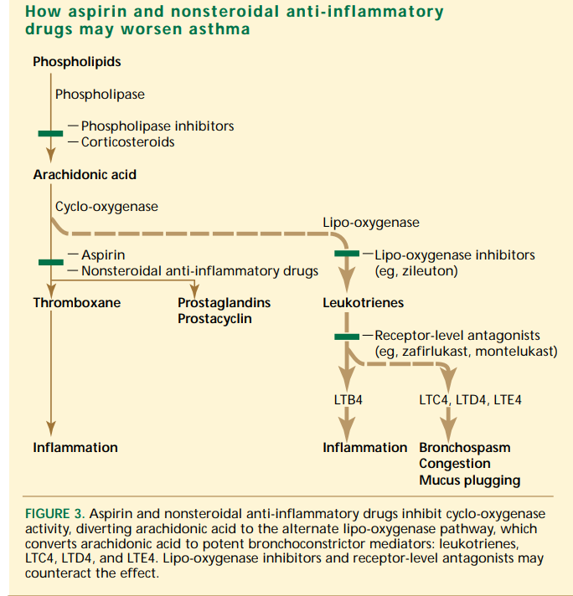

Slide 14
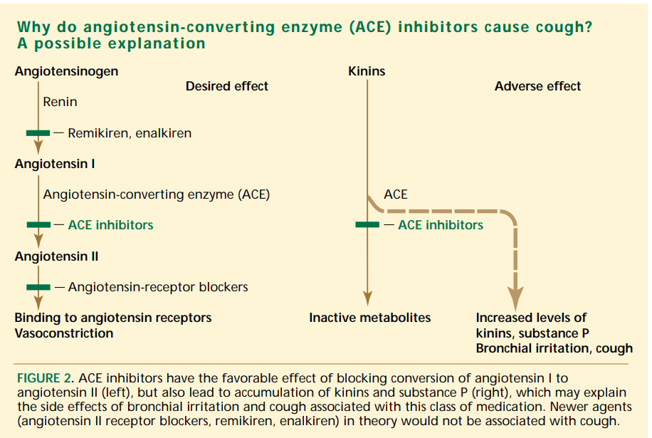

Slide 15
Treatment
The treatment of drug-induced lung disease consists of immediately discontinuing the offending drug and appropriately managing the pulmonary symptoms.
Acute episodes of drug-induced pulmonary disease usually disappear 24-48 hours after the drug has been discontinued, but chronic syndromes may take longer to resolve

Slide 16

Thank you

